Slide 1
ONLINE GROCERY APPLICATION
TEAM MEMBERS AND ENROLLMENT NO:-
LAKSHANA G: EBEON0322585493
NIVETHA M : EBEON0322582467
SURYA R : EBEON0322576846
SELVAGANAPATHY B: EBEON0322584732
AARATI KILLEDAR :EONFWL583387
AKSHAY:
Guided by
A.Varadharajan. B.Tech,ME,MBA,MISTE,AIENGG

Slide 2
PROJECT MODULES
Admin Login
Product Management
Customer Login
Customer Registration
SSO (Single Sign On)
View product
Add cart
Payment Option
Chart Bot

Slide 3
MODULES DESCRIPTION
Goal Of project:-
Save time and travel expense to buy your daily needs.
❖ One-click and handy shopping.
❖ Provide an online platform for every customer.
Provide on time delivery.
List of My modules and Sub models :-
SMS(Customer Notification)
Approach third party Website
Customer Registration
MYSQL Connection With Crud Operation

Slide 4
SMS(Customer Notification)
DEFINITION:-
A Delivery notifications messages send to customers about their packages‘s progress and get delivery details.Benefit using sms notification
Decrease customer support costs
Increase customer loyalty
SUB MODULES DETAILS:
Approach third party Website:-
In this module, we using third-party tool named Twilio along with Spring Boot Application which provides a feature to make a send the SMS to customer for delivery purpose

Slide 5
CUSTOMER REGISTRATION
Definition:
First time Customers of the support service who do not have a Username or Password, can select the New Account on the Login screen.
Sub module details:
MY SQL connection with crud operation
Using an entity annotation , getter and setter method to approaching the crud operation

Slide 6
Challenging issues
White label error page
No mapping found for HTTP request
Compilation failure [ERROR] or Build Failure compiler is provided in this environment.
Server port issue

Slide 7
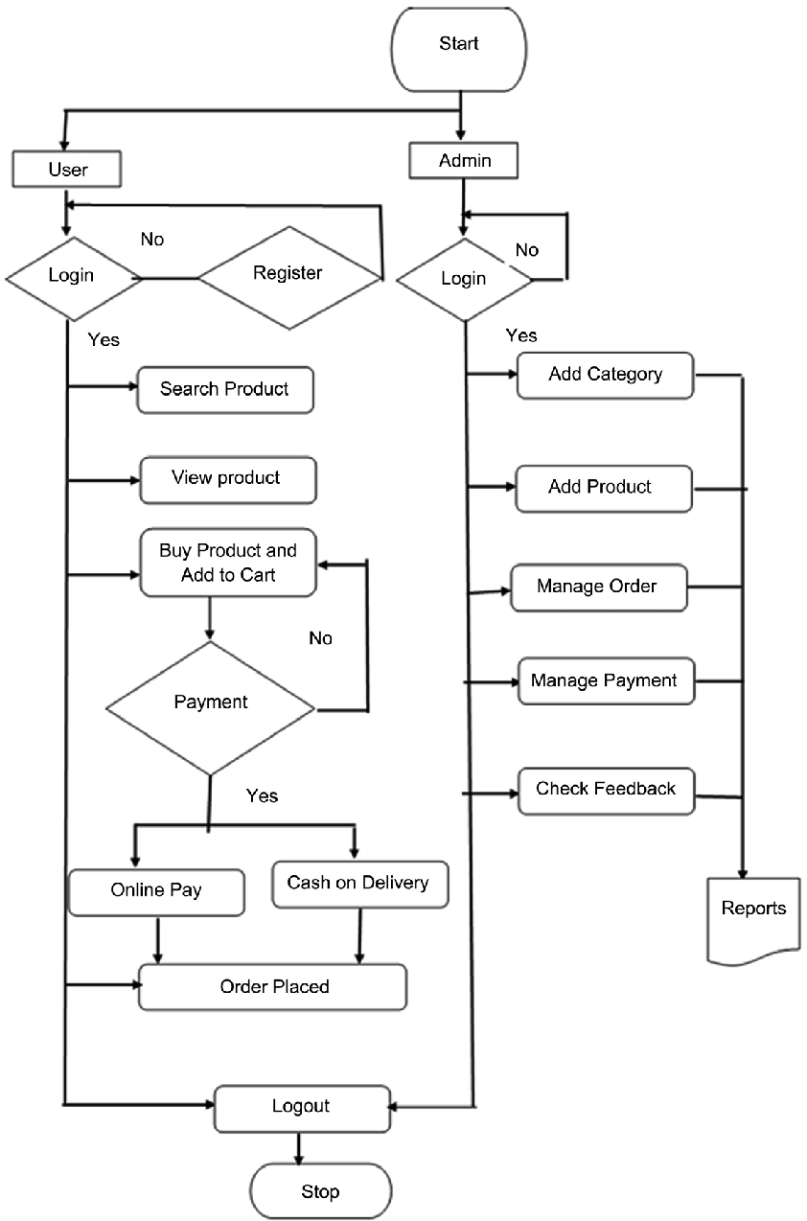
Project overview

Slide 8
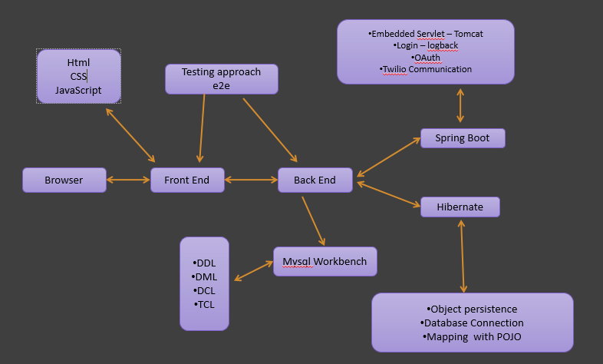
Tech architecture

Slide 9
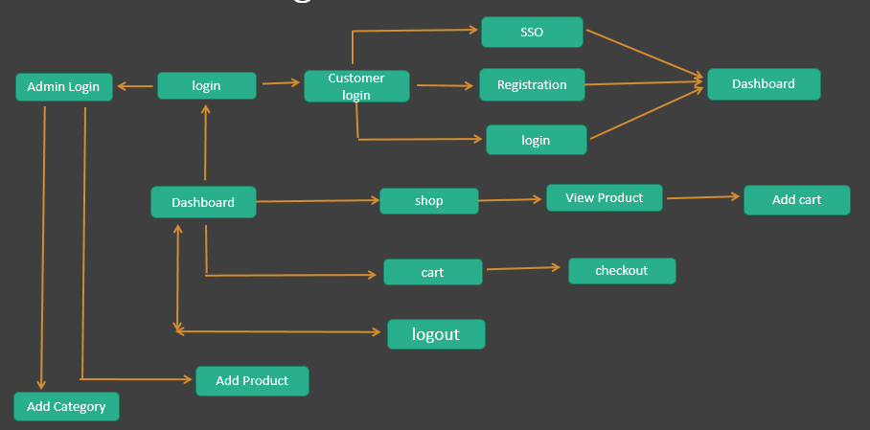
Dataflow diagram

Slide 10
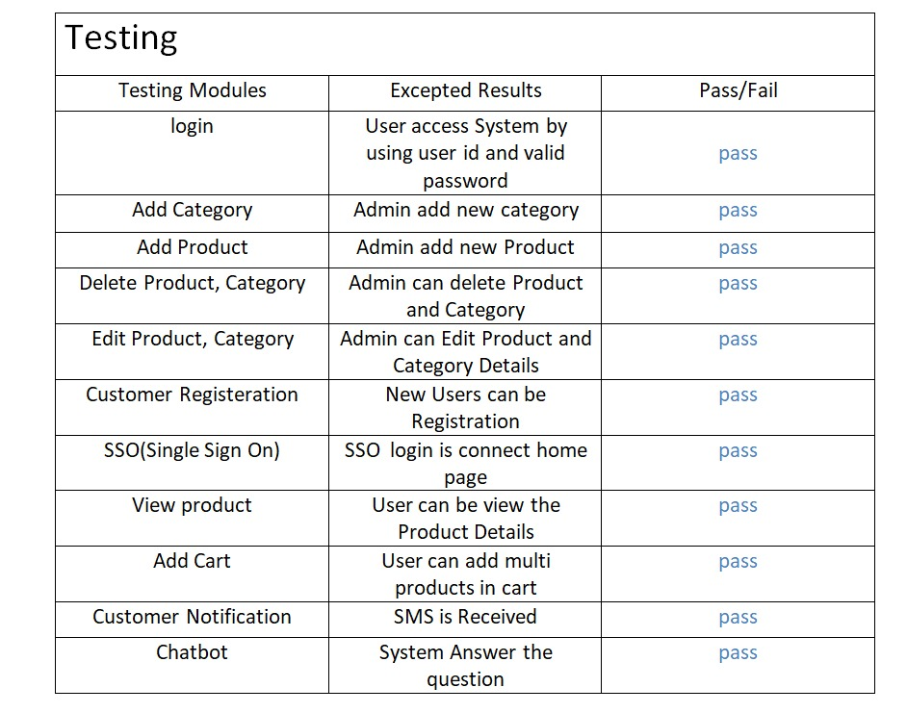
Testing
Manual testing approach

Slide 11
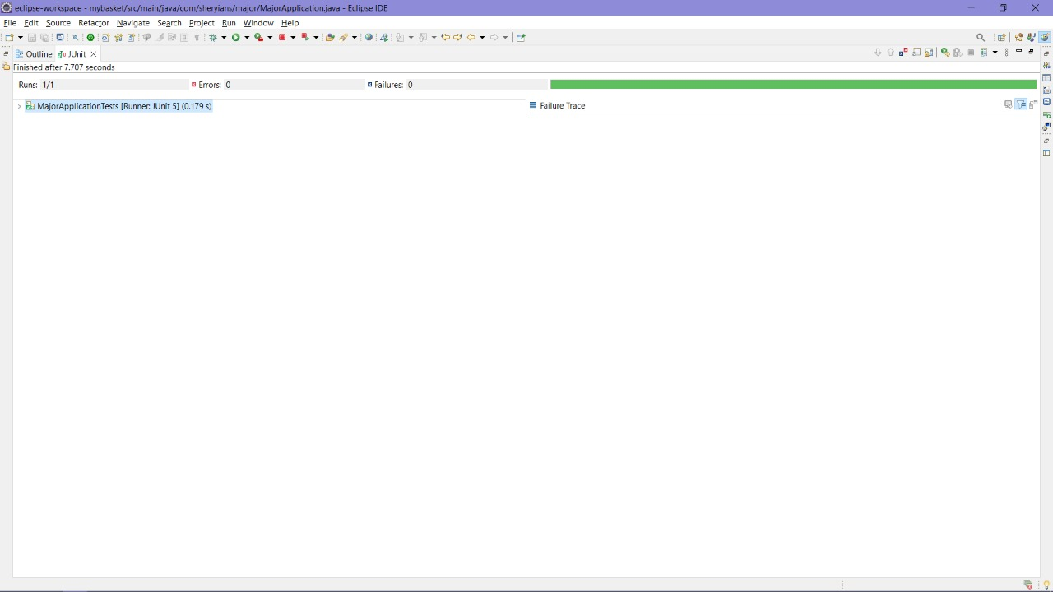
Devops Tools Approach
Junit Testing Tool
Maven
Git hub
Mysql Work bench
Tomcat

Slide 12
Features of module
SMS(Customer Notification)
SMS notification allows future marketing opportunities
SMS notification is cost and time saving
SMS notification allows an e Commerce to communicate faster
Customers registration
Online registration systems are secure
Real time update about the statistics
Immediate confirmation

Slide 13
Future enhancement
The current system can be extended to allow the users to create accounts and save products in to wish list.
The users could subscribe for price alerts which would enable them to receive messages when price for products fall below a particular level.
The current system is confined only to the shopping cart process. It can be extended to have an easy to use check out process
. Users can have multiple shipping and billing information saved. During check out they can use the drag and drop feature to select shipping and billing information

Slide 14
Conclusion
The ‘Online Shopping’ is designed to provide a web based application that would make searching, viewing and selection of a product easier. The search engine provides an easy and convenient way to search for products where a user can Search for a product interactively and the search engine would refine the products available based on the user’s input. The user can then view the complete specification of each product. They can also view the product reviews and also write their own reviews.

